Slide 1

Week 2 DB System Concepts & Architecture
Uzaira Saeed uzaira.saeed@google.com

Slide 2
Road Map
Data Models, Schema & Instances
Three-Schema Architecture
DB Languages & Interfaces
DB System Environment
Centralized & Client-Server Environment
Classes of DBMSs

Slide 3
Data Models, Schema & Instances

Slide 4
Data Model
“A set of concepts to describe the structure of a database”.
Database Structure includes data types, relationships and constraints that apply to the data to be stored inside the database.
Most Data Models also include some basic “Operations”
Specify data retrieval and updates

Slide 5
Data Model Operations Types
Basic Data Model Operations
Insert, delete, modify, retrieve etc…
User-Defined Operations
Calculate Profit %age
Calculate CGPA

Slide 6
Categories of Data Models
Conceptual or High-Level Data Models
Provide concepts that are close to the way many users perceive data.
Also called Entity-Based or Object-Based data models.
Uses concepts like entities, attributes and relationships
Entity represents a real-world concept or object
Attribute represents some property of interest describing further that entity…
Example: ER Model
Notes:
6
Inaccurate Estimate
Ineffective Control
Insufficient Tracking
Requirements not fulfilled

Slide 7
Categories of Data Models
Physical (low-level, internal) Data Models
Provide concepts that describe details of how data is stored in files
Represents information such as record format, record orderings and access path
“Access Path” is used to make the record search efficient within the file
Not of interest for end-users
Notes:
7
Inaccurate Estimate
Ineffective Control
Insufficient Tracking
Requirements not fulfilled

Slide 8
Categories of Data Models
Representational (implementation) Data Models
Is an intermediate approach between the above two
Do on focus on storage details
Stable enough to be implemented on Computer System directly
Also called “record-based” data models
Example: legacy models (network and hierarchical), relational data model
Notes:
8
Inaccurate Estimate
Ineffective Control
Insufficient Tracking
Requirements not fulfilled

Slide 9
Schema
Description of a database specified during DB Design is called “Schema”
Displayed Schema is called “Schema Diagram”
Each Object of schema is called “Schema Construct”
Notes:
9
Inaccurate Estimate
Ineffective Control
Insufficient Tracking
Requirements not fulfilled

Slide 10
Instance
Data in database at a particular time is called “Database State” or “Snapshot”
It is also called the current set of “Occurrences” or “Instances” in DB
Notes:
10
Inaccurate Estimate
Ineffective Control
Insufficient Tracking
Requirements not fulfilled

Slide 11
Difference between Instance & Schema
States of Database
Empty State
Initial State
Populated
Current State
DBMS is partially responsible that your Database only takes “valid states”
i.e. it satisfies the structure and constraints given in schema
Schema constructs and constraints are called “Meta-Data”
Notes:
11
Inaccurate Estimate
Ineffective Control
Insufficient Tracking
Requirements not fulfilled

Slide 12
Difference between Instance & Schema
Meta-Data is the data about data.
Schema is also called “Intension”
Database State is called “Extension of Schema”
Adding a new field (Data Item) in a “Record” is called “Schema Evolution”
Notes:
12
Inaccurate Estimate
Ineffective Control
Insufficient Tracking
Requirements not fulfilled

Slide 13
Three-Schema Architecture DETAILS

Slide 14
Important Characteristics of Database Approach
The three characteristics of DB Approach
Use of Catalog to store DB Description (Schema)
Insulation of programs
Program-data and method independence
Support for multiple user Views
Three-Schema DB Architecture was proposed to achieve the above three characteristics…
Notes:
14

Slide 15
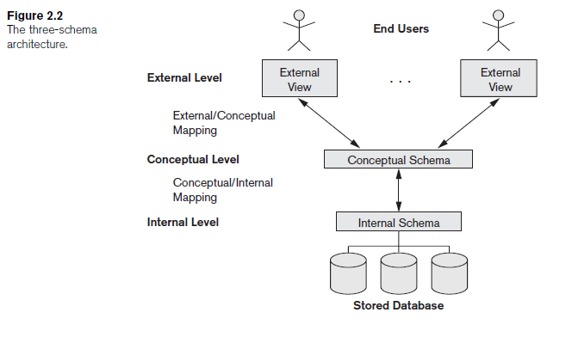
Three-Tier DB Architecture
Notes:
15
Inaccurate Estimate
Ineffective Control
Insufficient Tracking
Requirements not fulfilled

Slide 16
Data Independence
“Capacity of changing schema at one level without effecting the other levels.”
Two Types:
Physical Data Independence
Physical Storage Devices can be changed without effecting Conceptual Schema
Logical Data Independence
Conceptual Schema can be changed without effecting External Schema
Notes:
16
Inaccurate Estimate
Ineffective Control
Insufficient Tracking
Requirements not fulfilled

Slide 17
Data Independence
It means that upper levels should stay un-effected by changes in data in lower levels.
PHSICAL DATA INDEPENDANCE | LOGICAL DATA INDEPENDANCE
Modifications are done to improve performance | Modifications are done when DB structure is altered
Not difficult | Changes require a lots of thought process
Have to be objective of “Conceptual and External Schema” | Have to be objective of “External Schema”
Notes:
17
Inaccurate Estimate
Ineffective Control
Insufficient Tracking
Requirements not fulfilled

Slide 18
Databases Languages & Interfaces

Slide 19
DBMS Languages
Once the DB design is complete, the first step is to specify physical and conceptual schema and their mappings
DDL (Data Definition Language) is used for Conceptual Schema specification
SDL (Storage Definition Language) is used for Internal Schema specification
DBMS will compile it to identify and store schema construct in DB Catalog
Notes:
19
Inaccurate Estimate
Ineffective Control
Insufficient Tracking
Requirements not fulfilled

Slide 20
DBMS Languages
Mappings between the two levels will be given in one of the above two mentioned languages
In latest DBMS Internal Schema is specified by a combination of functions and parameters
View Definition Language (VDL) will specify the User Views and their mappings to Conceptual Schema
In most DBMS DDL includes both SDL and VDL
Notes:
20
Inaccurate Estimate
Ineffective Control
Insufficient Tracking
Requirements not fulfilled

Slide 21
DBMS Languages
Once the DBMS Schema is established, we need DML (Data Manipulation Language)
DML has commands for Insert, Update and Delete for data
DML has two types:
Non-Procedural or High-Level DML
Procedural or Low-Level DML
Notes:
21
Inaccurate Estimate
Ineffective Control
Insufficient Tracking
Requirements not fulfilled

Slide 22
Non-Procedural or High-Level DML
Focus on “what/which” data is to be fetched
Can be used on it’s own or with some general-purpose programming language
Uses “declarative” approach as it fetch multiple records in one DML Stmt
Also known as “set-at-a-time” or “set-oriented” DMLs
Notes:
22
Inaccurate Estimate
Ineffective Control
Insufficient Tracking
Requirements not fulfilled

Slide 23
Non-Procedural or High-Level DML
Two types:
Formal Query Language
Relational Algebra
Relational Calculus
Commercial Query Language
Notes:
23
Inaccurate Estimate
Ineffective Control
Insufficient Tracking
Requirements not fulfilled

Slide 24
Procedural or Low-Level DML
Focuses on “how” data is to be fetched
Retrieves records from DB and process each separately
Can only be used with some general purposed programming language to use constructs like loop as it is one record at-a-time
Notes:
24
Inaccurate Estimate
Ineffective Control
Insufficient Tracking
Requirements not fulfilled

Slide 25
More on DML
When some DML commands are embedded in some general purposed programming language then
That language is called “Host Language”
And DML is called “Data Sub-language”
High-Level DML when used stand-alone is called “Query Language”.
Notes:
25
Inaccurate Estimate
Ineffective Control
Insufficient Tracking
Requirements not fulfilled

Slide 26
DBMS Interfaces
Menu Based Interfaces for Web Browsing
Query is composed step-b-step by selecting options from the up-coming menus
Forms Based Interfaces
Normally forms are designed for naïve users
Mostly used for inserting data into the database
Some DBMS support Form-based language for easy forms development by programmers e.g. SQL*Forms and Oracle Forms
Notes:
26
Inaccurate Estimate
Ineffective Control
Insufficient Tracking
Requirements not fulfilled

Slide 27
DBMS Interfaces
Graphical User Interfaces
Displays schema information to users diagrammatically
You can alter the schema using queries or by mouse and key-board help
Natural Language Interfaces
Free-form textual commands are used
It is a latest phenomenon. Research is going on “key-word based querying”
Speech Input & Output
Speech input is detected using a dictionary of pre-defined words
Notes:
27
Inaccurate Estimate
Ineffective Control
Insufficient Tracking
Requirements not fulfilled

Slide 28
DBMS Interfaces
Interfaces for Parametric Users
Screens are available with limited input options for users like Bank users etc…
Interfaces for DBA
Screens for sophisticated commands are available like user Account Creation, changing Schema etc…
Notes:
28
Inaccurate Estimate
Ineffective Control
Insufficient Tracking
Requirements not fulfilled

Slide 29
DBMS Environment

Slide 30
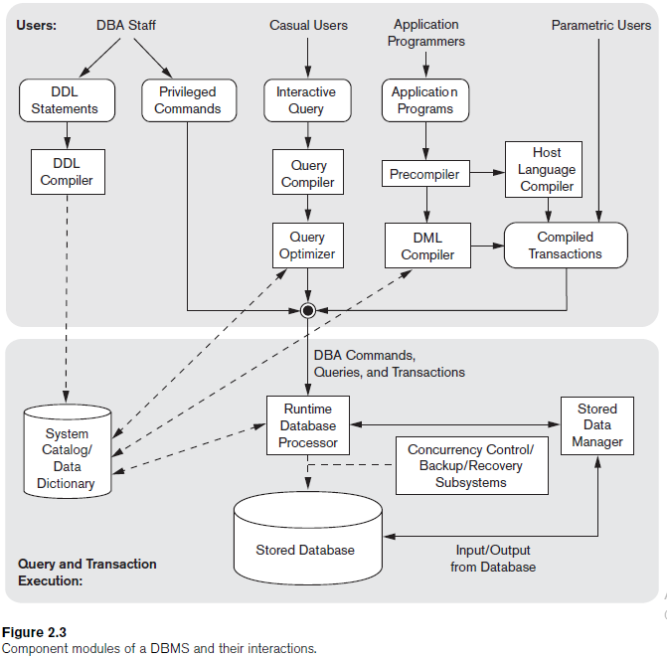
DBMS Component Modules

Slide 31
DBMS Component Modules
Upper Part shows the users of DB
Lower Part shows data storage mechanisms of DB
DB and DBMS Catalog are controlled by OS as it schedules disk read/ write
Some DBMS have their own buffer to reflect better performance
A higher-level “stored data module” controls access to DBMS information
Notes:
31
Inaccurate Estimate
Ineffective Control
Insufficient Tracking
Requirements not fulfilled

Slide 32
DBMS Component Modules
DBA staff works on DB optimization using DDL and other commands
DDL compiler processes DDL commands and stores schema descriptions in DB
Casual Users interact with DB using “Interactive Query” interface where the queries specified are compiled by “query compiler” resulting into some form.
Notes:
32
Inaccurate Estimate
Ineffective Control
Insufficient Tracking
Requirements not fulfilled

Slide 33
DBMS Component Modules
Application Programmers write programs which are sent to pre-compiler.
Pre-compiler compiles DML code into Object code of DB
Rest of code is send to native language compiler
Notes:
33
Inaccurate Estimate
Ineffective Control
Insufficient Tracking
Requirements not fulfilled

Slide 34
DBMS Component Modules
Runtime DB Processor executes
Privileged commands
Executable Query plans
Canned Transactions with run-time parameters
Runtime DB Processor also manages DB buffers
Runtime DB Processor works in collaboration with “concurrency control” and “backup and recovery system” for stable transaction management
Notes:
34
Inaccurate Estimate
Ineffective Control
Insufficient Tracking
Requirements not fulfilled

Slide 35
DB System Utilities
To perform certain functions such as:
Loading the data stored in files into a database using “conversion tools”.
Backing up the database periodically on tape.
Reorganizing database file structures.
Report generation utilities.
Performance monitoring utilities.
Other functions, such as sorting, user monitoring, data compression, etc.

Slide 36
Other Tools
Data dictionary / repository:
Used to store schema descriptions and other information such as design decisions, application program descriptions, user information, usage standards, etc.
Active data dictionary is accessed by DBMS software and users/DBA.
Passive data dictionary is accessed by users/DBA only.
Application Development Environments and CASE (computer-aided software engineering) tools:
Examples – Power builder (Sybase), Builder (Borland)

Slide 37
Centralized & Client/ Server Architectures for DBMS

Slide 38
Centralized DBMS Architectures
A single Database located at 1 site on a network
Advantages
Get a complete View of Data
Manage, Update & Backup is easier
Disadvantages
Multiple users accessing the same file slows down productivity

Slide 39
Basic Client/ Server Architecture
Devised to deal with Computing Environment in a large number of PCs, file servers, printers etc.
It is possible to have a file server that holds files for all workstations and clients connected to it…
Likewise print Server, Web Server, Email Server are other specialized Servers

Slide 40
Basic Client/ Server Architecture
“Client” machines allow local services, installed on them, as well as specialized screens to utilize the Server!
“Server” contains hardware and software services enough to allow resources to clients

Slide 41
Two-Tier Client/ Server Architecture
We have a “Server” and one or more “Client(s)”
Server holds DB and Client has the User Interface and Application Program
Works very well with lesser number of clients
As clients increase performance of the system is degraded

Slide 42
Two-Tier Client/ Server Architecture
Interface called ODBC (Open Database Connectivity) provides an Application program interface (API) allow client side programs to call the DBMS.
Most DBMS vendors provide ODBC drivers.
A client program may connect to several DBMSs.
Other variations of clients are possible: e.g., in some DBMSs, more functionality is transferred to clients including optimization and recovery across multiple servers, etc. In such situations the server may be called the Data Server.

Slide 43
Three & n-Tier Client/ Server Architecture
More Complex System
Common for Web applications
Intermediate Layer called Application Server or Web Server:
stores the web connectivity software and the rules and business logic (constraints) part of the application used to access the right amount of data from the database server
sends partially processed data between the database server and the client.
Additional Features- Security:
encrypt the data at the server before transmission
decrypt data at the client

Slide 44
Classification of DBMS

Slide 45
Classification Criteria of DBMS
Data Model
Traditional: Relational, Network, Hierarchical.
Emerging: Object-oriented, Object-relational.
Number of Users:
Single User, Multiple Users
DBMS Architecture
Centralized (uses a single computer with one database) vs. distributed (uses multiple computers, multiple databases)
Other classifications
Cost, OS and other Technical Reasons

Slide 46
Q & A
?

Slide 47
Thank You

